Slide 1

Phylogenetic comparative methods using R
Dr Manabu Sakamoto
Senior Lecturer in Zoology
University of Lincoln

Slide 2
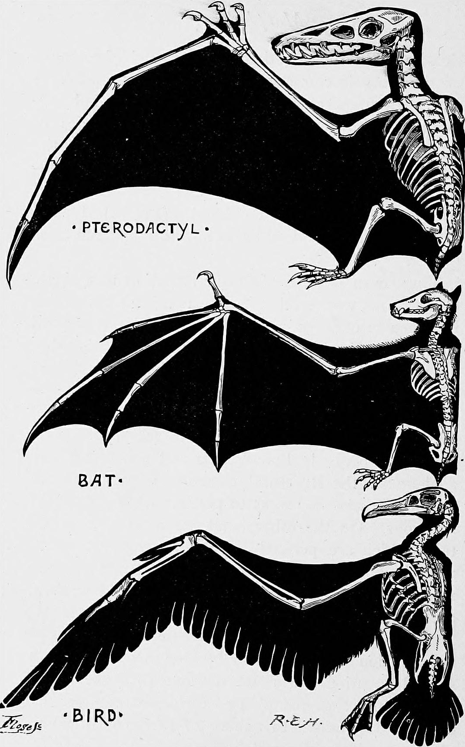
Why phylogeny is important
“Nothing in Biology Makes Sense Except in the Light of Evolution”
Theodosius Dobzhansky
Phylogeny is a record of evolutionary history
Any study taking a comparative framework requires “tree-thinking”
Wings of flying vertebrates are not homologous
Derived from separate ancestors and through independent evolutionary histories.

Slide 3
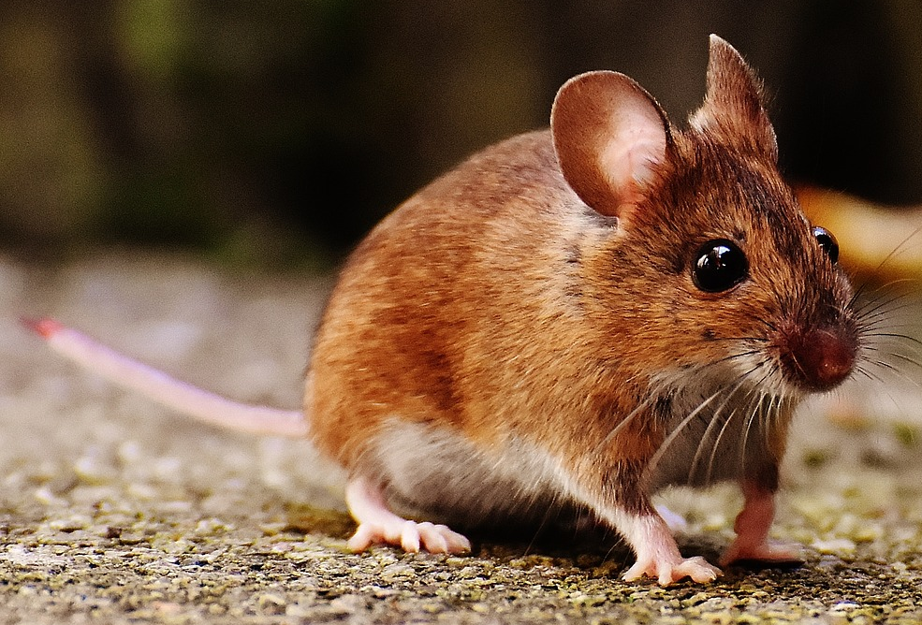
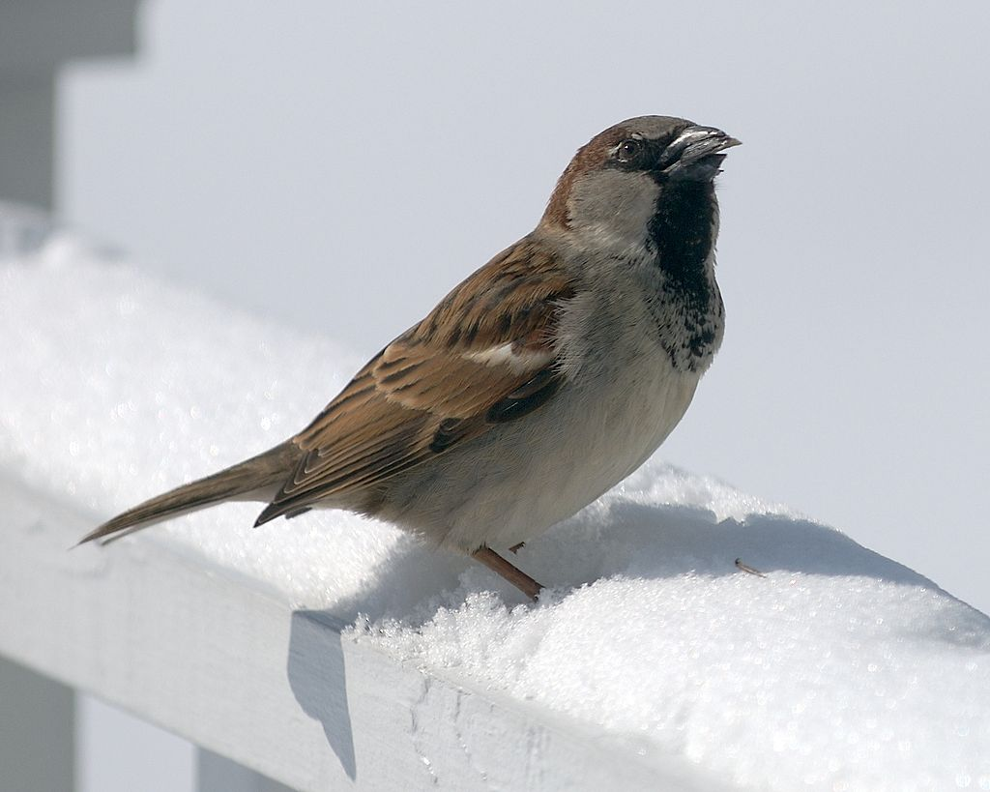
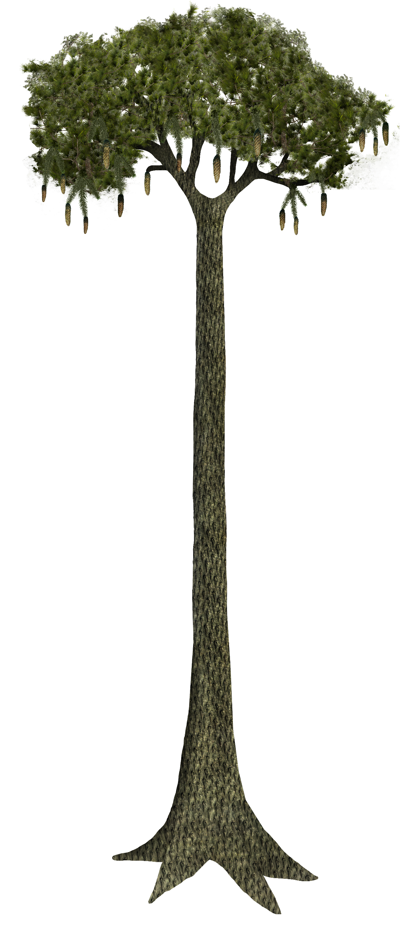
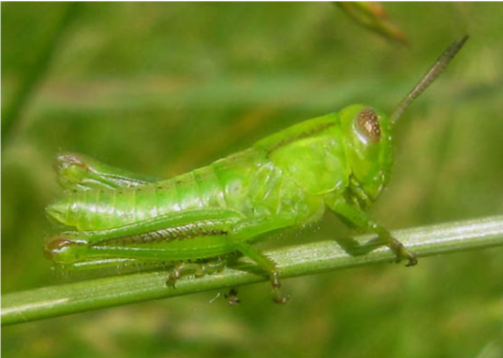
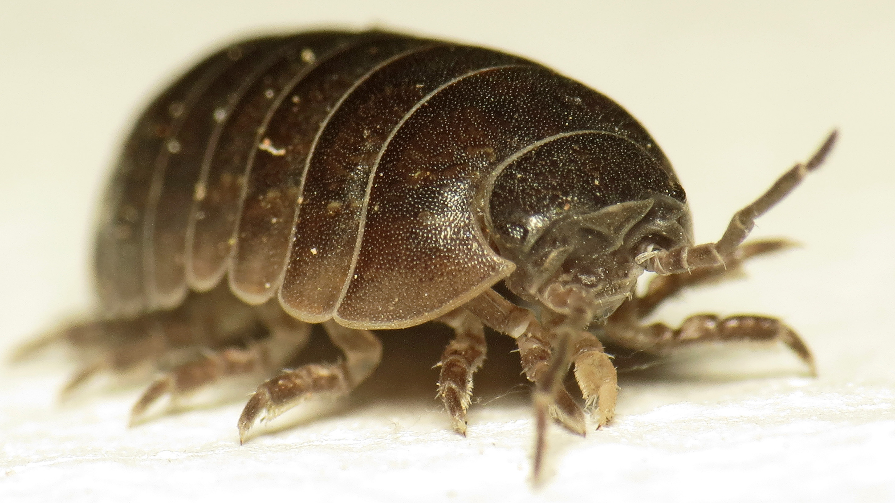
Why phylogeny is important
Suppose we are comparing traits across five taxa.
Directly comparing pairs assumes all comparisons are equal.

Slide 4
Why phylogeny is important
Phylogenetic statement made with such a comparison is that all taxa are independent of each other.
Star phylogeny!

Slide 5
Why phylogeny is important
In reality, some taxa are more closely related to each other than they are to others.
Comparisons are not equivalent!
Phylogenetic structure in comparisons
Tree thinking underlies all comparative biology
Toxicology
Pharmacology
Comparative data analysis

Slide 6
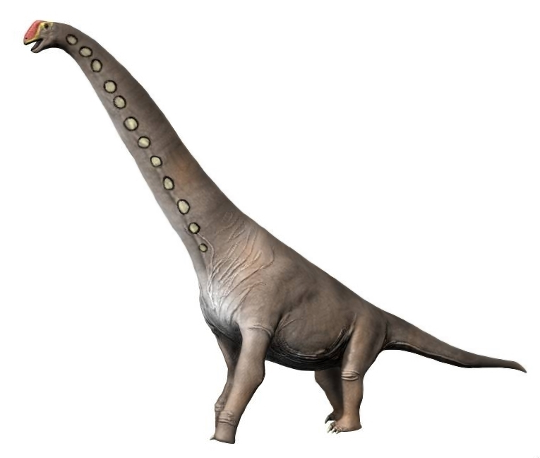
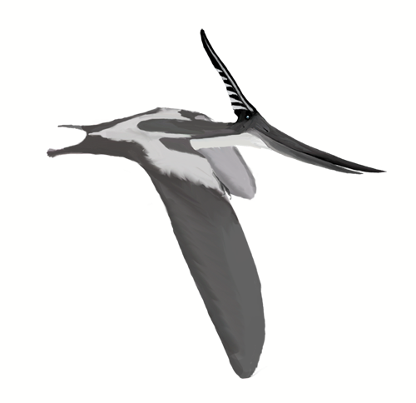
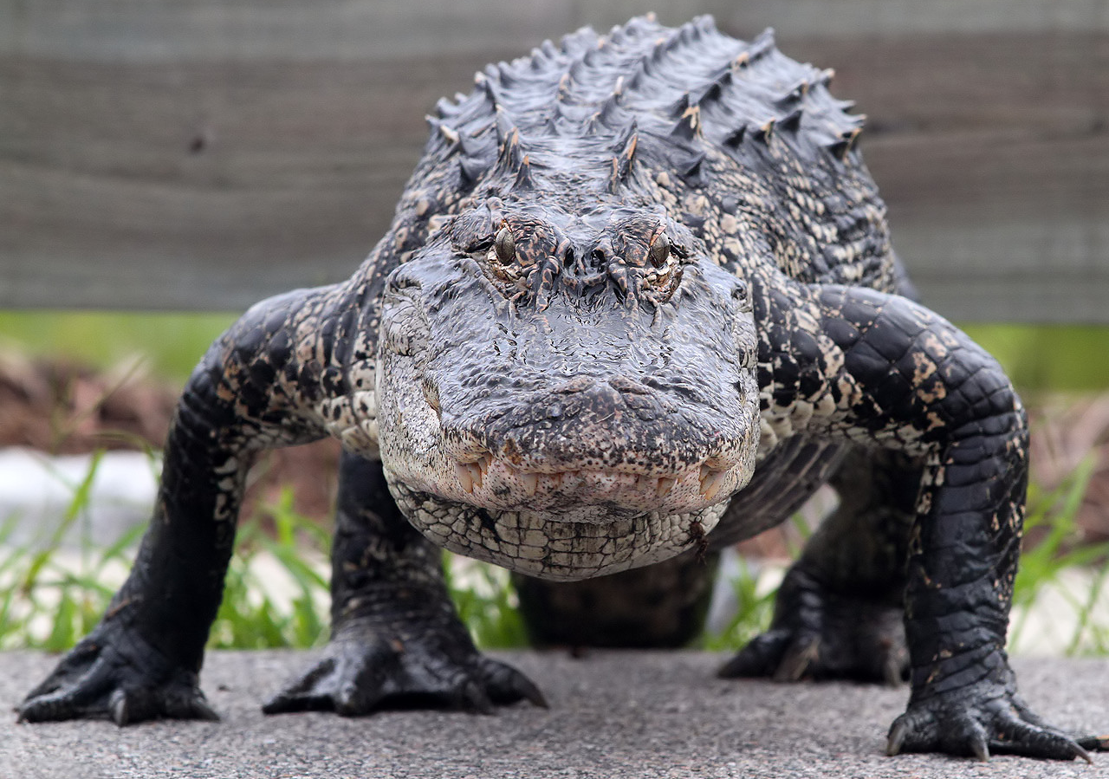
Comparative data
In comparative data, observations (taxa) are not independent of each other.
Some taxa share more with each other than with others
Phylogenetic non-independence

Slide 7
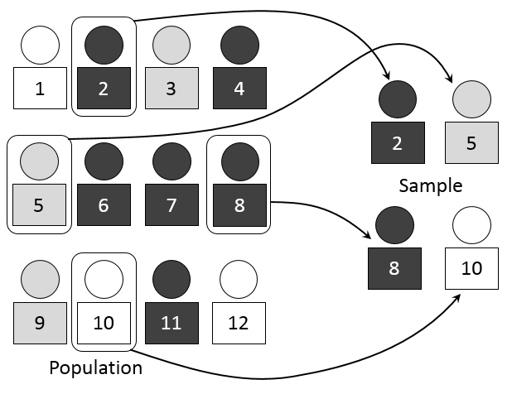
Statistics assume independence
In statistics, observations (data points) in a dataset are assumed to be independent.
Various methods are available to attain independent sampling.
However, comparative cross-species data are not independent.
Violates a fundamental assumption of statistical testing.

Slide 8
Consequences of non-independence
Null hypothesis of ‘no significant relationship’ could be incorrectly rejected…
Statistical tests are compromised
P-values are unreliable
Inflated type I error rates
False positive
Rejecting a true null hypothesis
e.g., convicting an innocent defendant
Incorrectly rejecting the null hypothesis that the defendant is innocent until proven guilty by using biased evidence.

Slide 9
Phylogenetic comparative methods
Phylogenetic comparative methods (PCM) are a statistical framework to take into account phylogenetic non-independence
Available for most statistical tests and models
t-test
ANOVA
Regression/GLM
Models of evolution

Slide 10
Phylogenetic non-independence in PCM
Phylogenetic non-independence structure can be represented as a phylogenetic variance-covariance (VCV) matrix
Diagonal (variance)
Root-tip path
Off-diagonals (covariance)
Pairwise shared paths
A
B
C
D
2
2
Phylogenetic VCV
1
3
Time
 | A | B | C | D
A | 4 | 2 | 1 | 0
B | 2 | 4 | 1 | 0
C | 1 | 1 | 4 | 0
D | 0 | 0 | 0 | 4
4
1
Covar
Var

Slide 11
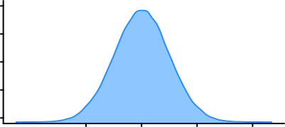
Expected variance in trait data
Expected species variance in trait data is proportional to the lengths of the branches from the root of the phylogeny to the tip.
Expected covariance between pairs of species is proportional to the shared phylogenetic path
X_{A}
A
B
C
D
X_{B}
X̅
Trait VCV
V_{B} = X_{B} - X̅
V_{A} = X_{A} - X̅
 | A | B | C | D
A | V_{A} | V_{AB} | V_{AC} | V_{AD}
B | V_{BA} | V_{B} | V_{BC} | V_{BD}
C | V_{CA} | V_{CD} | V_{C} | V_{CD}
D | V_{DA} | V_{DB} | V_{DC} | V_{D}
Sample variance
X̅
Covariance V_{A}V_{B}

Slide 12
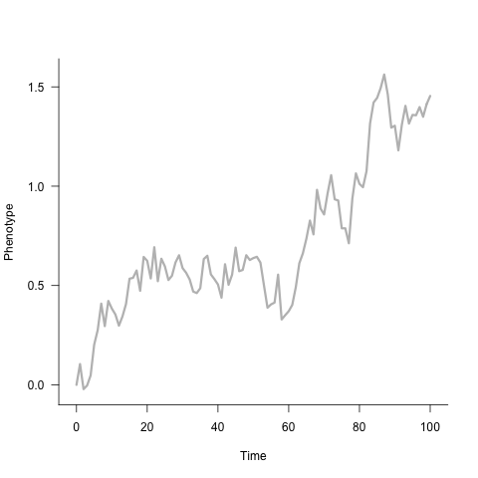
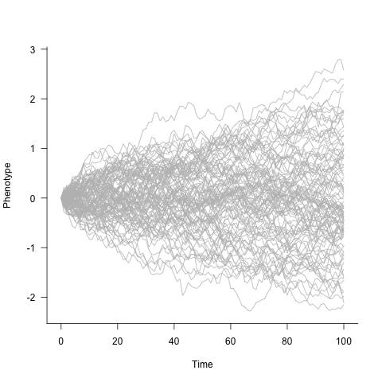
Brownian Motion evolution
Under Brownian motion, changes in trait value occurs at a consistent rate (instantaneous rate 𝜎²) through time
Change is proportional to time
𝛥X = 𝜎² x 𝛥t
Direction of change at each interval is random (random walk)
Change doesn’t depend on the state of the trait
Simulated Brownian motion trait evolution
1 random simulation
100 random simulations

Slide 13
BM generates trait variance
The funnel-shaped increase in variance is the expected variance of the species given the amount of time elapsed since the root of the phylogenetic tree and with instantaneous rate 𝜎².
V_{A}

Slide 14
Phylogenetic structure in trait VCV
The expected VCV structure of a trait evolving under Brownian motion is proportional to a phylogenetic VCV of the branch lengths in units of time t.
A
B
C
D
∑t_{A}
∑t_{B}
Expected trait VCV
Phylogenetic VCV
 | A | B | C | D
A | V_{A} | V_{AB} | V_{AC} | V_{AD}
B | V_{BA} | V_{B} | V_{BC} | V_{BD}
C | V_{CA} | V_{CD} | V_{C} | V_{CD}
D | V_{DA} | V_{DB} | V_{DC} | V_{D}
 | A | B | C | D
A | ∑t_{A} | ∑t_{AB} | ∑t_{AC} | ∑t_{AD}
B | ∑t_{BA} | ∑t_{B} | ∑t_{BC} | ∑t_{BD}
C | ∑t_{CA} | ∑t_{CB} | ∑t_{C} | ∑t_{CD}
D | ∑t_{DA} | ∑t_{DB} | ∑t_{DC} | ∑t_{D}
∑t_{C}
Time
∑t_{D}
∝
∑t_{AB}
Covar
Var

Slide 15
Departure from Brownian
What if observed trait variance doesn’t conform to BM?
Rate of evolution is not constant.
Trait VCV is not proportional to phylogenetic VCV
A
B
C
D
∑t_{A}
∑t_{B}
Observed trait VCV
Phylogenetic VCV
 | A | B | C | D
A | V_{A} | V_{AB} | V_{AC} | V_{AD}
B | V_{BA} | V_{B} | V_{BC} | V_{BD}
C | V_{CA} | V_{CD} | V_{C} | V_{CD}
D | V_{DA} | V_{DB} | V_{DC} | V_{D}
 | A | B | C | D
A | ∑t_{A} | ∑t_{AB} | ∑t_{AC} | ∑t_{AD}
B | ∑t_{BA} | ∑t_{B} | ∑t_{BC} | ∑t_{BD}
C | ∑t_{CA} | ∑t_{CB} | ∑t_{C} | ∑t_{CD}
D | ∑t_{DA} | ∑t_{DB} | ∑t_{DC} | ∑t_{D}
∑t_{C}
Time
∑t_{D}
∝
∑t_{AB}
Covar
Var

Slide 16
Homogeneous departure from BM
Departure from BM is homogeneous across the whole tree.
VCV matrix can be scaled uniformly
A
B
C
D
Scalar applied across whole VCV matrix
∑t_{A}
∑t_{B}
Trait VCV
Phylogenetic VCV
 | A | B | C | D
A | V_{A} | V_{AB} | V_{AC} | V_{AD}
B | V_{BA} | V_{B} | V_{BC} | V_{BD}
C | V_{CA} | V_{CD} | V_{C} | V_{CD}
D | V_{DA} | V_{DB} | V_{DC} | V_{D}
 | A | B | C | D
A | ∑t_{A} | ∑t_{AB} | ∑t_{AC} | ∑t_{AD}
B | ∑t_{BA} | ∑t_{B} | ∑t_{BC} | ∑t_{BD}
C | ∑t_{CA} | ∑t_{CB} | ∑t_{C} | ∑t_{CD}
D | ∑t_{DA} | ∑t_{DB} | ∑t_{DC} | ∑t_{D}
∑t_{C}
Time
∑t_{D}
∝
∑t_{AB}
Covar
Var

Slide 17
Modelling uniform departures from BM
Pagel’s 𝜆
Noise at the tips
Scale VCV by 𝜆
Early/Late Burst (EB/LB) model
Rates vary through time.
All elements of VCV raised to the power of 𝛿.
Ornstein-Uhlenbeck (OU) model
Modified BM model with additional parameters 𝜃 and 𝛼
𝜃: evolutionary optimum
𝛼: strength of pull towards 𝜃
A
B
C
D
Time
Off-diagonal of VCV scaled by 𝜆

Slide 18
Branch transformations
Branches scaled by 𝜆 = 0.25
Branches scaled by estimated OU 𝛼
Branches unscaled
A couple of examples of branch transformations using estimated model parameters, 𝜆 and 𝛼.
𝜆 scales (compresses) internal branches.
𝛼 also has similar effects on branch lengths but more extreme.
Both model independent evolution along the terminal branches.

Slide 19
Rate heterogeneity across the phylogeny
Variable-rates model
Departure from BM is very often idiosyncratic and varies across the phylogeny.
Cannot be accounted for by a tree-wide uniform modifier.
Branch modified by rate scalar r
D
Uniform modifier is not sufficient
A
B
C
∑t_{A}
∑t_{B}
Trait VCV
Phylogenetic VCV
 | A | B | C | D
A | V_{A} | V_{AB} | V_{AC} | V_{AD}
B | V_{BA} | V_{B} | V_{BC} | V_{BD}
C | V_{CA} | V_{CD} | V_{C} | V_{CD}
D | V_{DA} | V_{DB} | V_{DC} | V_{D}
 | A | B | C | D
A | ∑t_{A} | ∑t_{AB} | ∑t_{AC} | ∑t_{AD}
B | ∑t_{BA} | ∑t_{B} | ∑t_{BC} | ∑t_{BD}
C | ∑t_{CA} | ∑t_{CB} | ∑t_{C} | ∑t_{CD}
D | ∑t_{DA} | ∑t_{DB} | ∑t_{DC} | ∑t_{D}
∑t_{C}
Time
r∑t_{D}
∝
∑t_{AB}
Covar
Var

Slide 20
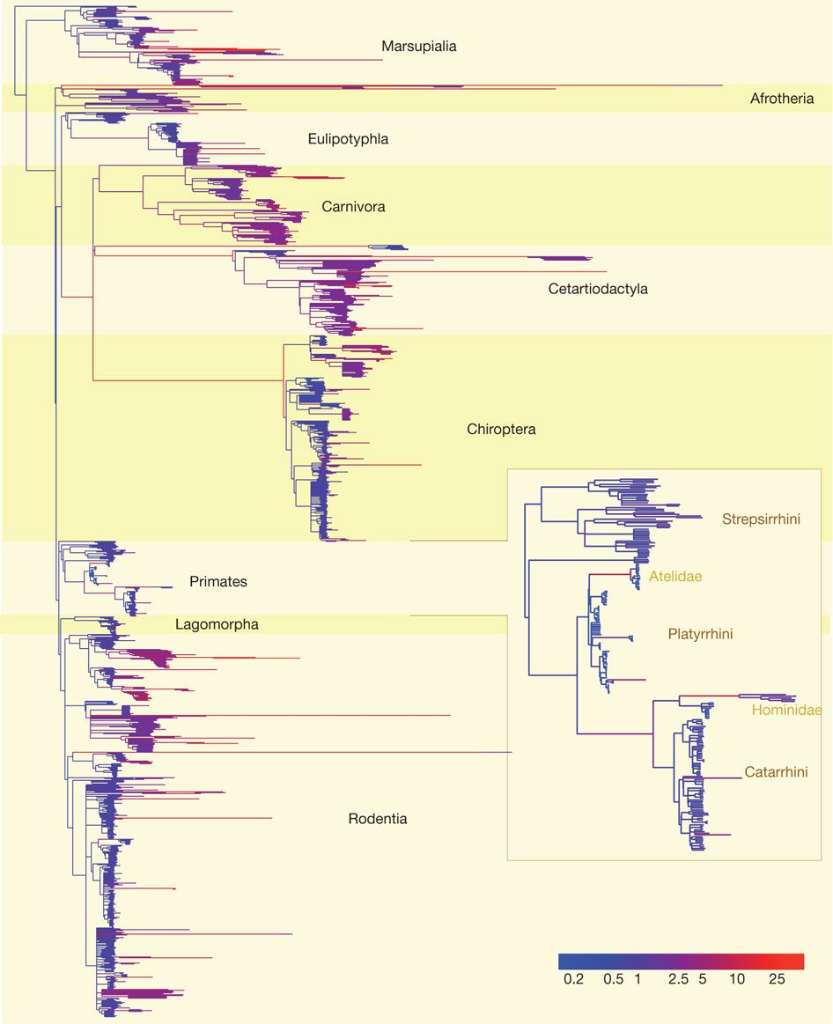
Variable-rates (VR) model
Rates of evolution vary along branches of a phylogenetic tree
Branches scaled so that phenotypic trait evolution conforms to BM
Two types of rate shift
Branch-shift
Rate shift along each individual branch
Clade-shift
Rate shift along all branches within a clade
Clade-wide variance increase/decrease
Venditti et al., 2011. Nature 479: 393-396

Slide 21
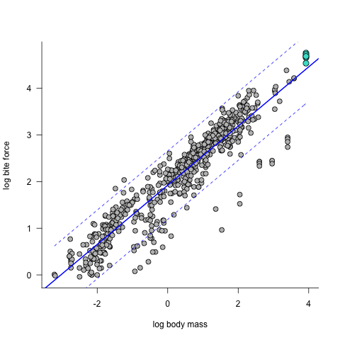
Phylogenetic generalised linear models
Many PCMs are effectively implemented as generalised linear models (GLM).
Regression is a type of GLM.
GLM is a flexible framework that can:
handle various data types
incorporate phylogenetic VCV structure
model phenotypic evolution
x_{A}
x_{B}
x_{C}
x_{D}
A
B
C
D
y_{A}
y_{B}
y_{C}
y_{D}
Time
 | A | B | C | D
A | ∑t_{A} | ∑t_{AB} | ∑t_{AC} | ∑t_{AD}
B | ∑t_{BA} | ∑t_{B} | ∑t_{BC} | ∑t_{BD}
C | ∑t_{CA} | ∑t_{CB} | ∑t_{C} | ∑t_{CD}
D | ∑t_{DA} | ∑t_{DB} | ∑t_{DC} | ∑t_{D}
Expected VCV structure for the residuals

Slide 22
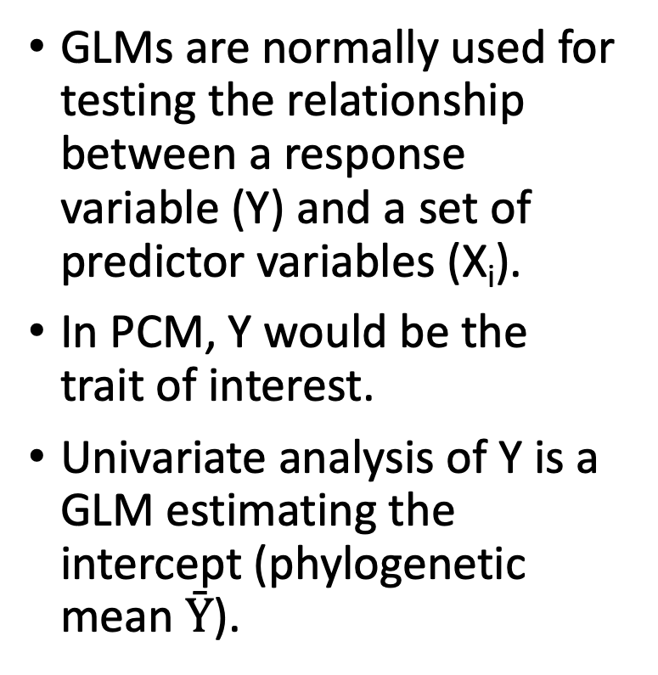
Phylogenetic generalised linear models
GLMs are normally used for testing the relationship between a response variable (Y) and a set of predictor variables (X_{i}).
In PCM, Y would be the trait of interest.
Univariate analysis of Y is a GLM estimating the intercept (phylogenetic mean $Ȳ$).
x_{A}
x_{B}
x_{C}
x_{D}
A
B
C
D
y_{A}
y_{B}
y_{C}
y_{D}
Time
Ȳ
Ȳ

Slide 23
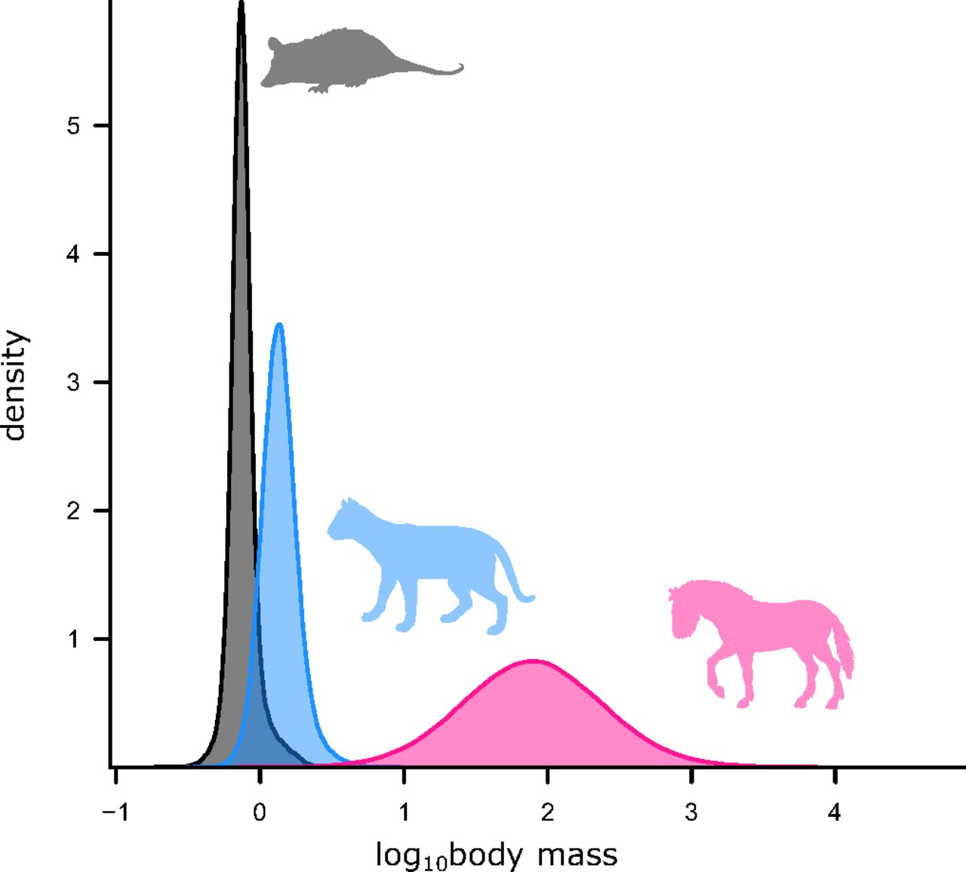
Phylogenetic generalised linear models
Phylogenetic t-test
Y is continuous
X is a binary-state variable
Tests difference in means between the two groups.
Phylogenetic ANOVA
Y is continuous
X is a multi-state categorical variable
e.g., dietary category

Slide 24
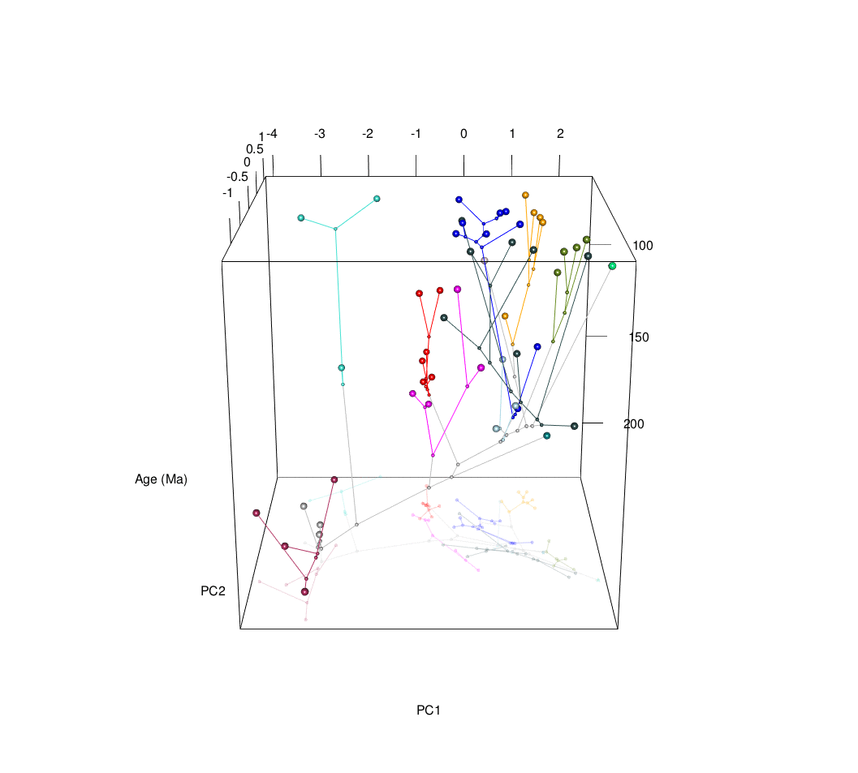
Phylogenetic regression
Phylogenetic generalised least squares (GLS)
Least squares regression with phylogenetic VCV
Phylogenetic generalised linear mixed model (GLMM)
Models phylogeny as a random effect

Slide 25

Phylogenetic generalised least squares
Least squares approach.
Minimises sum of squares of residuals
Phylogenetic non independence in residuals are accounted for by incorporating a phylogenetic VCV.
Implementations:
caper R package
BayesTraits

Slide 26
Phylogenetic generalised linear mixed model
Mixed effects model where the phylogenetic non independence is accounted for by incorporating a phylogeny as a random effect.
GLMM is a flexible approach that can model various types of Y, not just continuous variables (e.g., binary or count).
Y is continuous: Gaussian model – equivalent to a GLS.
Y is binary: Logit/probit model (aka, logistic regression)
Y is a count: Poisson model
Implementation:
MCMCglmm R package.

Slide 27
Practical demonstration
We will now learn how to run phylogenetic GLS and GLMM in R using the caper and MCMCglmm packages respectively.

Slide 28
Prerequisites
Required R libraries:
caper
MCMCglmm
geiger
Install caper and MCMCglmm:
install.packages(c(“caper”, “MCMCglmm”, “geiger”)
Download data and tree files:
https://github.com/manabusakamoto/ProgPal2022
data.txt: skull morphometrics in theropod dinosaurs
tree.nex: phylogenetic tree for theropods in nexus file format

Slide 29
Basic data handling
Navigate to the folder where you have your data and tree files and set it as your working directory.
setwd(“FILEPATH”)
# Replace “FILEPATH” with your own filepath to the desired folder.
Read in the data file as a data.frame object
df <- read.delim(“data.txt”, stringsAsFactors = F, header = T)
rownames(df) <- df$Taxon
Read in tree file
tr <- read.nexus("tree.nex")

Slide 30
Phylogenetic GLS
Load the caper library:
library(caper)
Set up comparative data object and call it dt.pgls (or whatever)
dt.pgls <- comparative.data(tr, df, Taxon, vcv=TRUE, vcv.dim=3)
Fit phylogenetic GLS model
pgls.1 <- pgls(L_PreOrbit ~ W_Sk, dt.pgls, lambda='ML’)
Check summary of GLS output
summary(pgls.1)

Slide 31
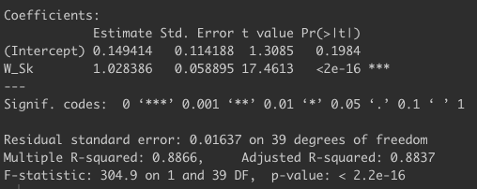
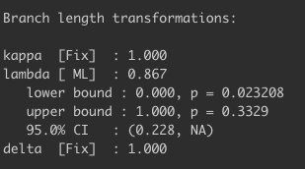
Phylogenetic GLS
Significant relationship between response variable L_PreOrbit and predictor variable W_Sk.
We’ve also estimated lambda in this model.
Lambda = 0.867
So there’s a bit of noise/departure from Brownian motion.

Slide 32
Phylogenetic GLS
We could visualise the branch transformation using the estimated lambda
# extract estimated lambda value from pGLS model
lambda <- pgls.1$param[2]
#load geiger R package
library(geiger)
# rescale branches by lambda
tr.lambda <- rescale(tr, "lambda", lambda)

Slide 33
Phylogenetic GLS
Branches unscaled
Branches scaled by 𝜆
Plot unscaled tree and lambda-scaled tree side by side
par(mfrow = c(1,2))
# plot unscaled tree
plot(tr, show.tip.label = F)
axisPhylo()
# plot lambda-scaled tree
plot(tr.lambda, show.tip.label = F)
axisPhylo()
layout(1) # reset graphics layout
Slight compression of internal branches

Slide 34
Phylogenetic GLMM
Now let’s try fitting a phylogenetic GLMM using the MCMCglmm package.
MCMCglmm uses a Bayesian implementation of GLMM.
This involves a bit more model set up – i.e., defining priors.

Slide 35
Phylogenetic GLMM
# Load MCMC R package
library(MCMCglmm)
# set priors
prior1 <- list(R = list(V=1, nu=0.002), G=list(G1 = list(V = 1, nu = 1, alpha.mu = 0, alpha.V = 25^2)))
# set number of iterations
nitt <- 5E05
# set sampling interval
thin <- 1E03
# set burnin
burnin <- 1E05

Slide 36
Phylogenetic GLMM
# create inverse of VCV matrix
invA <- inverseA(tr, scale=F)$Ainv
# fit MCMCglmm
pglmm.1 <- MCMCglmm(L_PreOrbit ~ W_Sk, data = df, random = ~ Taxon,
ginverse=list(Taxon=invA), family = "gaussian", prior=prior1,
nitt=nitt, thin=thin, burnin=burnin, pl=T)
# print out model summary
summary(pglmm.1)
Model formula
Trait distribution
Gaussian is normal distribution

Slide 37
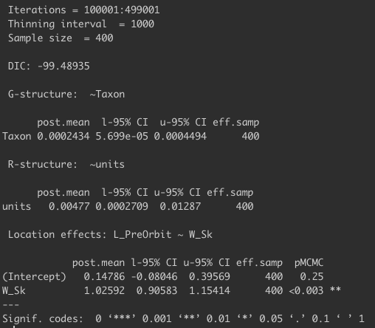
Phylogenetic GLMM
Significant relationship between response variable L_PreOrbit and predictor variable W_Sk.
Results are nearly identical to those from GLS.
GLS output
GLMM output

Slide 38
Phylogenetic GLMM
Bayesian analyses output distributions of model coefficients instead of a single estimate, so we can inspect how the estimates look like.
# plot MCMCglmm solutions, i.e., model coefficients
plot(pglmm.1$Sol)

Slide 39
Further considerations
Variable-rates (VR) phylogenetic GLMs are implemented in BayesTraits.
Can model rate heterogeneity across phylogeny.
MCMCglmm can model non-gaussian data, e.g.:
Count data: family = “poisson”
Speciation events
Binary data: family = “binomial”
Presence/absence or extinct/survived

